Slide 1
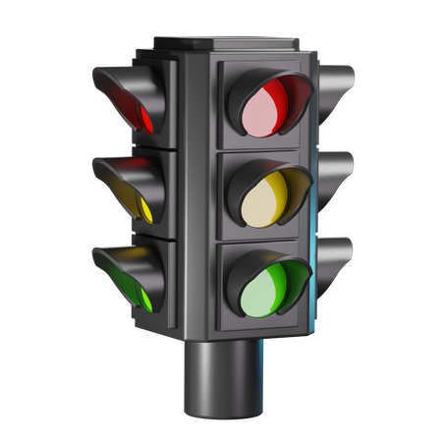
The 1st SmartCare AI Light
Team Name : OneAsia
Team member : 2
August 5, 2025

Slide 2





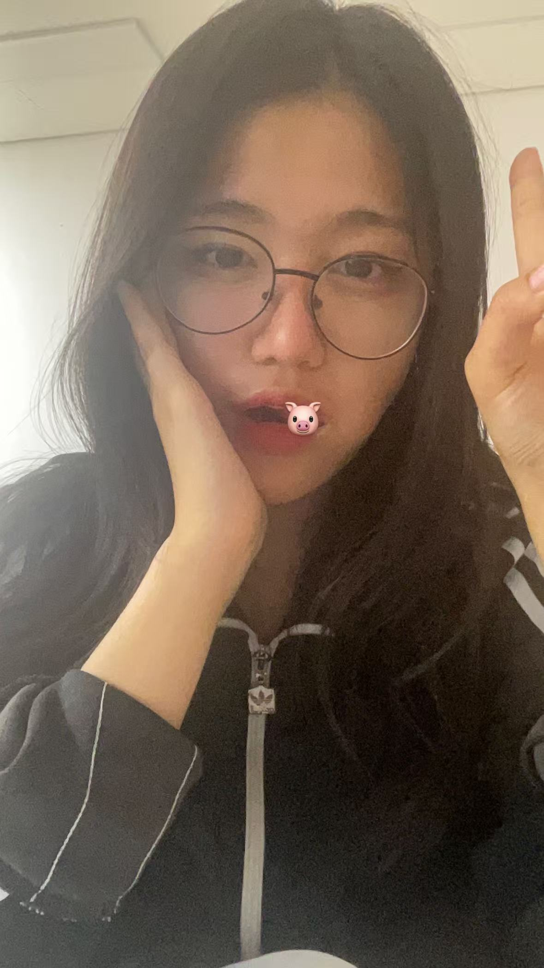

Team One Asia & Photo
KIM YOUBIN
HASHIMOTO KARIN
JIN GYEONGEUN
CAO GUOLIANG
ALIBOEV ABBOS
JO YOUNGSANG

Slide 3
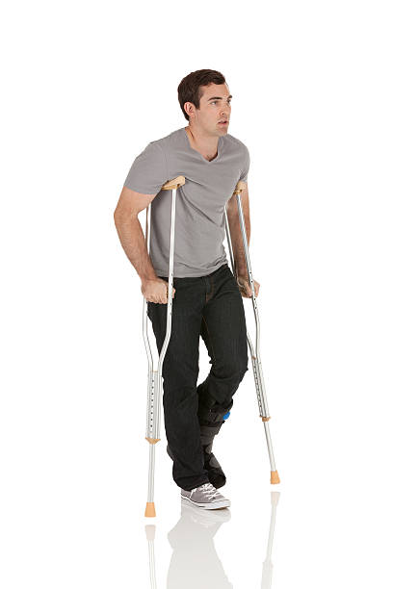
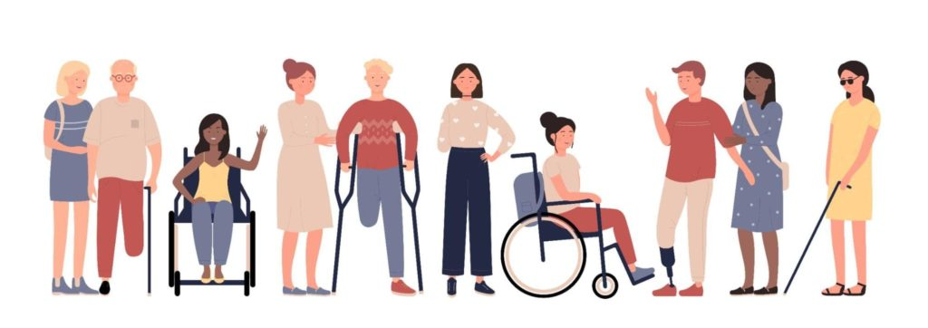
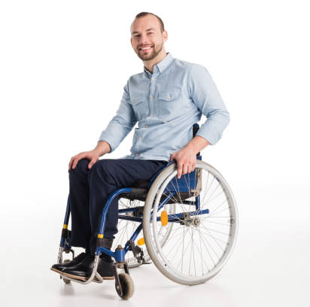
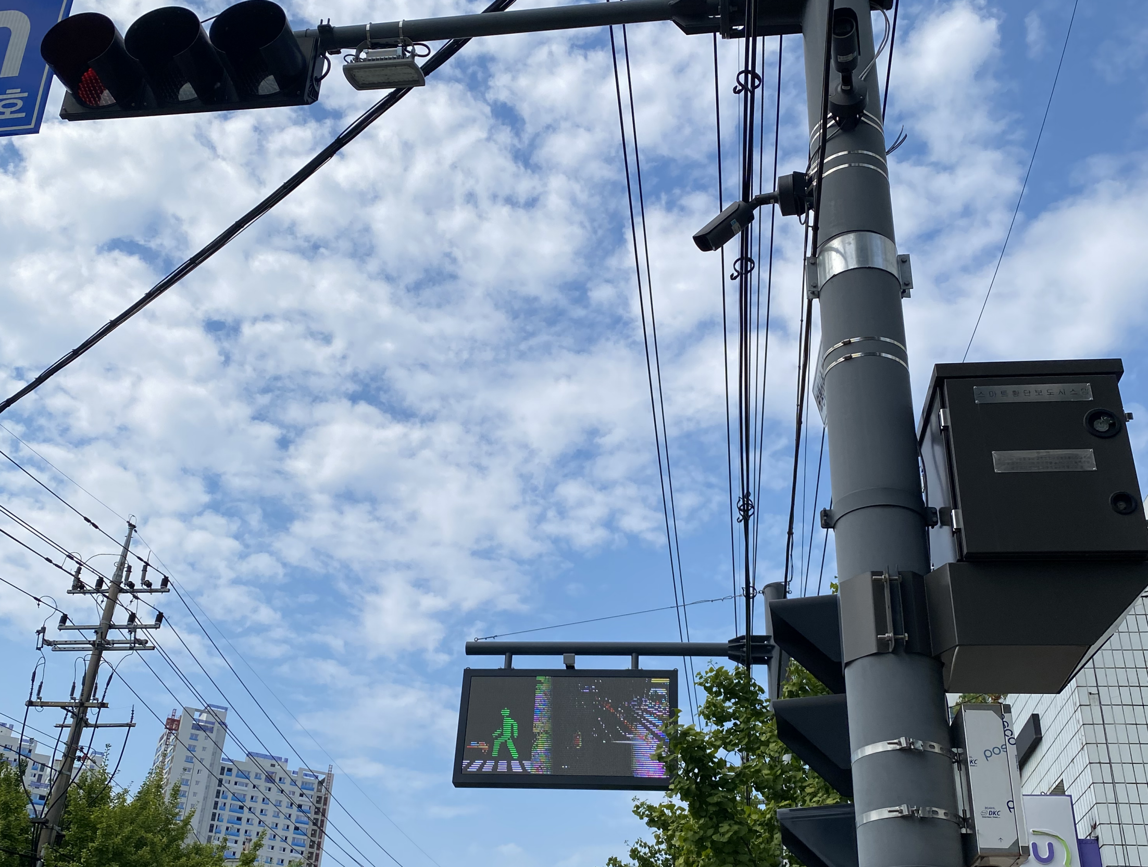
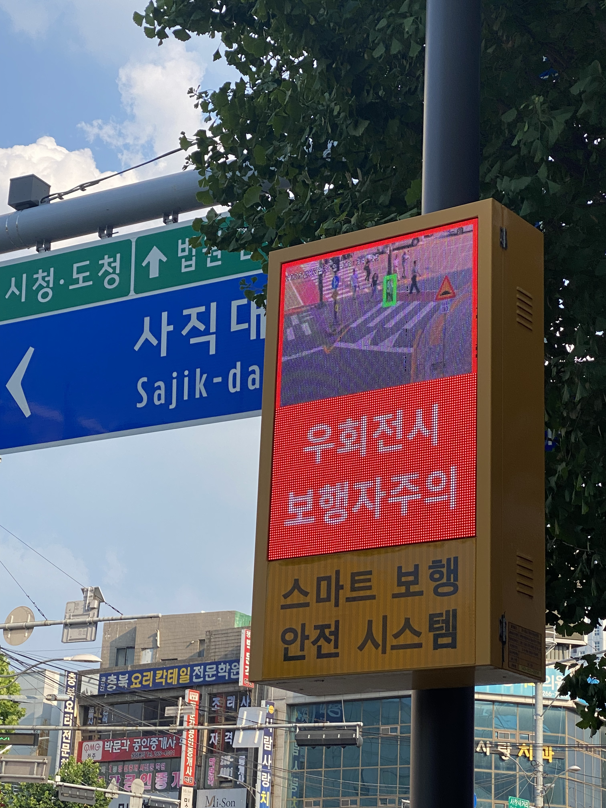

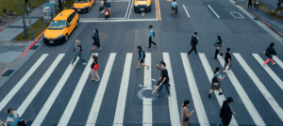
Background & Concept
1
3
Who will use it for what? People with disabilities or limited mobility Safe crossing, less stress, and more respect in public.
Why your product is expected?
Current lights treat everyone the same, but some people walk slower. This wastes green time and causes traffic jams.
In Korea, existing systems only show warnings — they don’t actually help.
✅ SmartCare AI Light uses AI to detect vulnerable pedestrians, extends the green light until they finish crossing, then gives cars their full green time — making traffic safer and smoother.
2
When and Where your product will be used? Use anytime, day or night. Especially at hospitals,
elderly homes, busy intersections, and school zones.

Slide 4
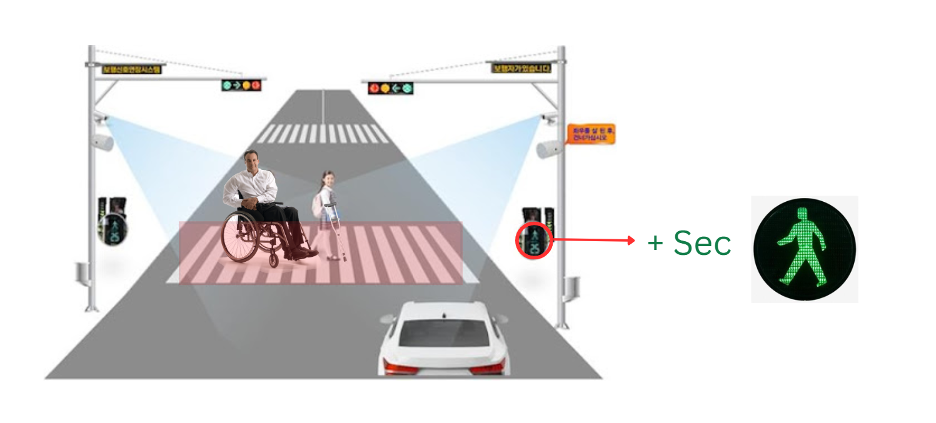
Idea with sketch
Sketch & Visual
Method 1
Method 2
YOLO-based Object
Detection Structure
Pose-based Flaw
Detection Structure
Camera Input
Camera Input
YOLOv8 Detection
Pose Estimation:
YOLO11-Pose
Detected Classes:
'wheelchair', 'cane', 'crutch'
Extracted Keypoints: 17 joints per person
If YES → vulnerable_pedestrian = True
Rule-based or ML-based Classification: wheelchair? cane?
If YES → vulnerable_pedestrian = True
Green light extended for
pedestrian
Green light extended for
pedestrian
After pedestrian crosses →
normal green light for vehicles
After pedestrian crosses →
normal green light for vehicles

Slide 5
Thanks!
Do you have any questions?
Team - One Asia

